Slide 1
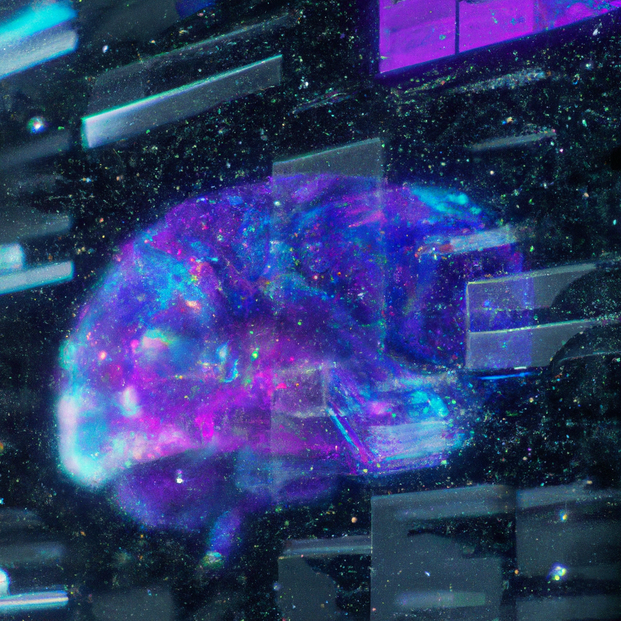
CNN-BASED METHOD FOR DETECTING BRAIN TUMOR CANCER PREDICTION USING MACHINE LEARNING
Presentation By S. Antony Edison, R. Mohamed Aseel, M.R Siva Sankaran

Slide 2
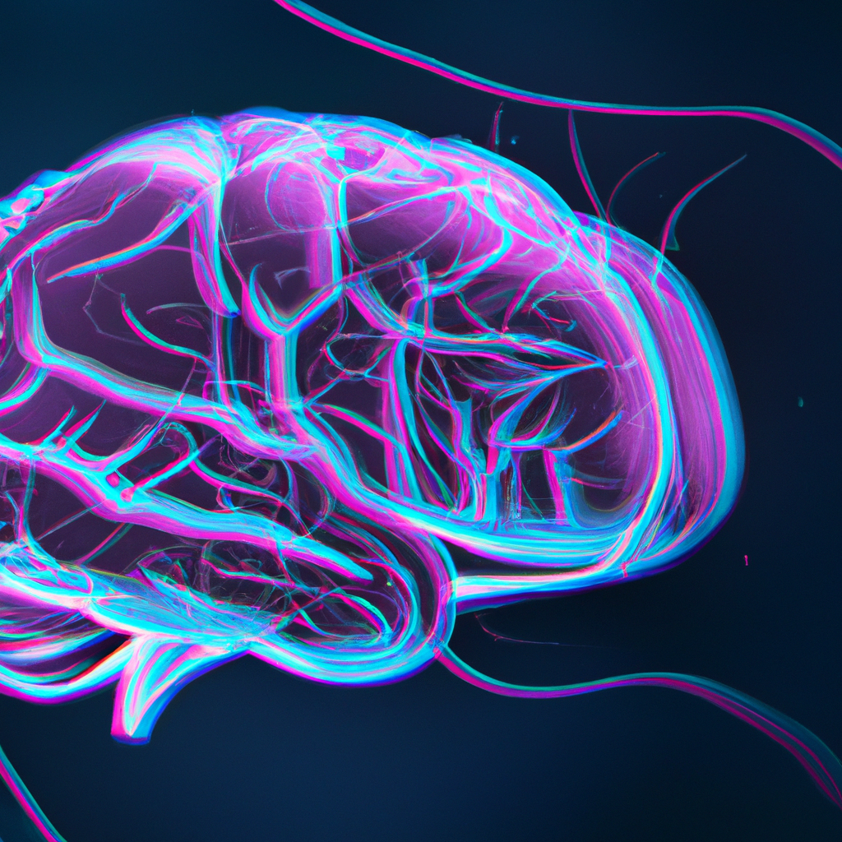
INTRODUCTION
Brain tumor is a serious health condition that affects millions of people worldwide. Early detection and treatment of brain tumor can significantly improve the chances of survival. In recent years, machine learning algorithms have shown great promise in detecting brain tumor from medical images such as MRI scans.
In this paper, we present a CNN-based method for detecting brain tumor cancer prediction using machine learning. Our approach involves training a deep convolutional neural network (CNN) on a large dataset of MRI scans to predict the presence of brain tumor with high accuracy.

Slide 3
ABSTRACT
This project proposes a method for detecting brain tumors in MRI images using the CNN algorithm.
The image is pre-processed using the Gaussian filter.
The filter performs spatial processing to reduce noise in an image.
This filter compares each pixel in the image to the surrounding pixels.
FCM segmentation is used for tumor segmentation, and morphological operations are used to accurately determine the size and shape of the tumor.
The CNN algorithm is used in this project.

Slide 4
CONTINUED
Convolutional neural networks are a well-ordered technique in the field of medical image processing.
A convolutional neural network (CNN) could be a type of artificial neural network that works in image recognition and is specifically designed for method component knowledge.
This project is implemented using Python Jupyter software

Slide 5
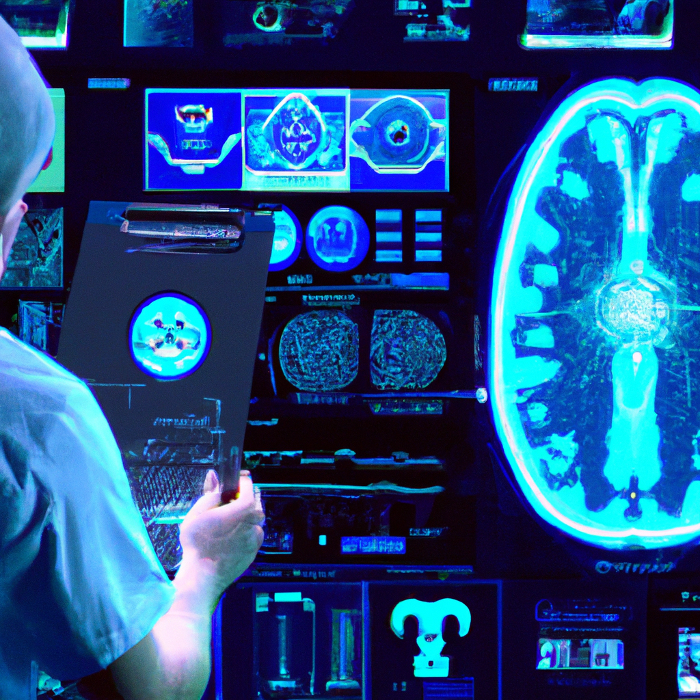
Benefits of CNN-Based Brain Tumor Cancer Prediction. The use of CNN-based brain tumor cancer prediction has several benefits. First and foremost, it can help doctors detect brain tumors in their early stages, which is crucial for successful treatment. Additionally, this technology can reduce the need for invasive procedures such as biopsies, which can be painful and carry risks of complications. Moreover, CNN-based brain tumor cancer prediction can save time and money by reducing the number of unnecessary tests and consultations. It can also improve patient outcomes by providing more accurate diagnoses and personalized treatment plans based on the specific characteristics of the tumor.

Slide 6
LITERATURE SURVEY
SL.NO | TITLE AND AUTHOR | METHODOLOGY USED | ADVANTAGES | DRAWBACKS
1. | ‘A Hybrid Feature Extraction Method With Regularized Extreme Learning Machine for Brain Tumor Classification’ & Abdu gumaei et al [2019] | In this paper propose a hybrid feature extraction method with a regularized extreme learning machine (RELM) for developing an accurate brain tumor classification approach. | The approach is more effective compared with the existing state-of-the-art approaches | For effective treatments, the accuracy of the current methods must be increased. It take a long time. It require a lot of training samples
2. | ‘Data Augmentation and Transfer Learning for Brain Tumor Detection in Magnetic Resonance Imaging’ & Andres Anaya - isaza et al [2022] | For the purpose of identifying brain tumors using magnetic resonance imaging, this paper proposes data augmentation and transfer learning technique. | An F1 detection score of 92.34% was possible due to the investigation | Deep learning networks require a lot of data. The deeper networks require a larger number of training parameters.

Slide 7
LITERATURE SURVEY
SL.NO | TITLE AND AUTHOR | METHODOLOGY USED | ADVANTAGES | DRAWBACKS
3. | ‘Neural Network Based Brain Tumor Detection Using Wireless Infrared Imaging Sensor’ & P. Mohamed Shakeel et al [2019] | In this paper proposes a wireless infrared imaging sensor for brain tumor detection using neural networks. | MLBPNN has an additional advantage of detecting whether the tumor is in early stage or in advanced stage. | Back spread has a few issues related with it which incorporate system loss of motion, nearby minima and moderate intermingling.
4. | ‘Machine Learning Assisted Methodology for Multiclass Classification of Malignant Brain Tumors’ & Ankit Vidyarthi et al [2022] | In this paper machine learning assisted methodology for multiclass classification of malignant brain tumors are proposed. | The developed feature selection algorithm called CVM is used as a methodology to locate the most relevant and non-redundant features | The methodology is not tested with some of the open accessible imaging datasets having abnormality characteristics.

Slide 8
LITERATURE SURVEY
SL.NO | TITLE AND AUTHOR | METHODOLOGY USED | ADVANTAGES | DRAWBACKS
5. | ‘On the Performance of Deep Transfer Learning Networks for Brain Tumor Detection Using MR Images’ & Saif Ahmad et al [2022] | In this paper, the effectiveness of deep transfer learning networks for detecting brain tumors using MR images is discussed. | A machine learning model performs better to produce more accurate results when the dataset is large and diverse. | Due to the long processing time, the system increases computational complexity.
6. | ‘Machine Learning and Deep Learning Approaches for Brain Disease Diagnosis: Principles and Recent Advances’ & Protima Khan et al [2021] | In this paper, machine learning and deep learning methods for diagnosing brain diseases are proposed, along with their guiding principles and most recent developments. | The implementation of the ELM-boosted structure was developed to increase learning ability. | These manual systems may lead to errors which can be serious for the patients.

Slide 9
SYSTEM DESIGN
The input image is pre-processed using the Gaussian filter.
This image is sent into the FCM segmentation block after pre-processing.
FCM segmentation is used to obtain accurate tumor size and shape.
The machine then produces the image with the tumor segmented.
The selected characteristics are fed into the convolutional neural network (CNN) classifier for machine learning image classification.
The number of features in an image should be kept to a minimum using this CNN classifier approach.
Finally, for improved accuracy, the CNN method is employed.

Slide 10
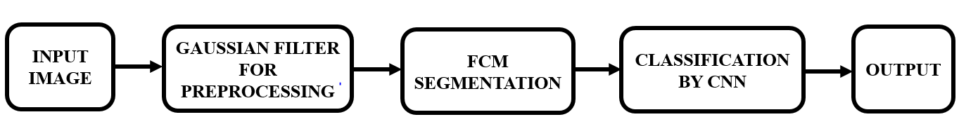
BLOCK DIAGRAM

Slide 11

TECHNIQUES USED
Pre-processing
Gaussian Filter
Segmentation
Fuzzy c-means (FCM)
Classification
Convolutional Neural Network (CNN)

Slide 12
DESCRIPTION
Gaussian Filter
A Gaussian filter is a linear filter.
A Gaussian Filter is a low pass filter used for reducing noise and blurring regions of an image.
The filter is implemented as an Odd sized Symmetric Kernel (DIP version of a Matrix) which is passed through each pixel of the Region of Interest to get the desired effect.
It's usually used to blur the image or to reduce noise.

Slide 13
CONTINUED…
Fuzzy c-means (FCM) Segmentation
Fuzzy C-means (FCM) is a method of clustering which allows one piece of data to belong to two or more clusters.
Fuzzy logic is a multi-valued logic derived from fuzzy set theory.
FCM is popularly used for soft segmentations.
Gives best result for overlapped data set and comparatively better than other algorithm.

Slide 14
CONTINUED…
Convolutional Neural Network (CNN)
A convolutional neural network (CNN) is a type of artificial neural network used primarily for image recognition and processing, due to its ability to recognize patterns in images.
CNNs can be trained to classify images, detect objects in an image, and even predict the next word in a sentence with incredible accuracy.
A CNN-based algorithm is mainly used for applications in image and speech recognition.

Slide 15
FUTURE ENHANCEMENT
There are several feature enhancements that could potentially improve the performance of a CNN-based method for detecting brain tumors in MRI images. Here are some suggestions:
Data augmentation: By applying different transformations to the existing MRI images, such as rotation, flipping, scaling, or adding noise, we can increase the size of the training dataset and improve the model's ability to generalize to new data.
Transfer learning: Pre-training the CNN on a larger dataset of general images, such as ImageNet, and then fine-tuning it on the brain MRI dataset can improve the model's ability to extract useful features from the input images.
Attention mechanisms: By adding attention mechanisms to the CNN architecture, the model can learn to focus on specific regions of the input image that are most relevant for tumor detection, leading to better performance

Slide 16
CONTINUED…
4. Ensemble models: Training multiple CNN models with different architectures or hyperparameters, and then combining their predictions, can improve the overall performance of the system.
5. Multi-modal data fusion: By combining different imaging modalities, such as T1-weighted, T2-weighted, and FLAIR MRI images, the model can learn to extract complementary information from each modality, leading to better performance.
6. Explainability: By incorporating methods for visualizing the learned features and decision-making process of the CNN, we can gain insights into the model's behavior and improve its interpretability for clinical use.
7. Incorporating domain knowledge: Expert knowledge about brain anatomy and tumor characteristics can be incorporated into the CNN architecture to guide the feature extraction process and improve the accuracy of the model.

Slide 17
CONTINUED…
8. Semi-supervised learning: Unlabeled MRI images can be used to augment the training dataset and improve the model's performance by leveraging self-supervision techniques or incorporating unsupervised learning methods.
9. Active learning: By incorporating active learning techniques, the model can learn to select the most informative samples for labeling, thereby reducing the amount of labeled data needed for training and improving the model's performance.
10. Adversarial training: Adversarial training can be used to improve the robustness of the CNN by training it to resist perturbations to the input images that are designed to fool the model.

Slide 18
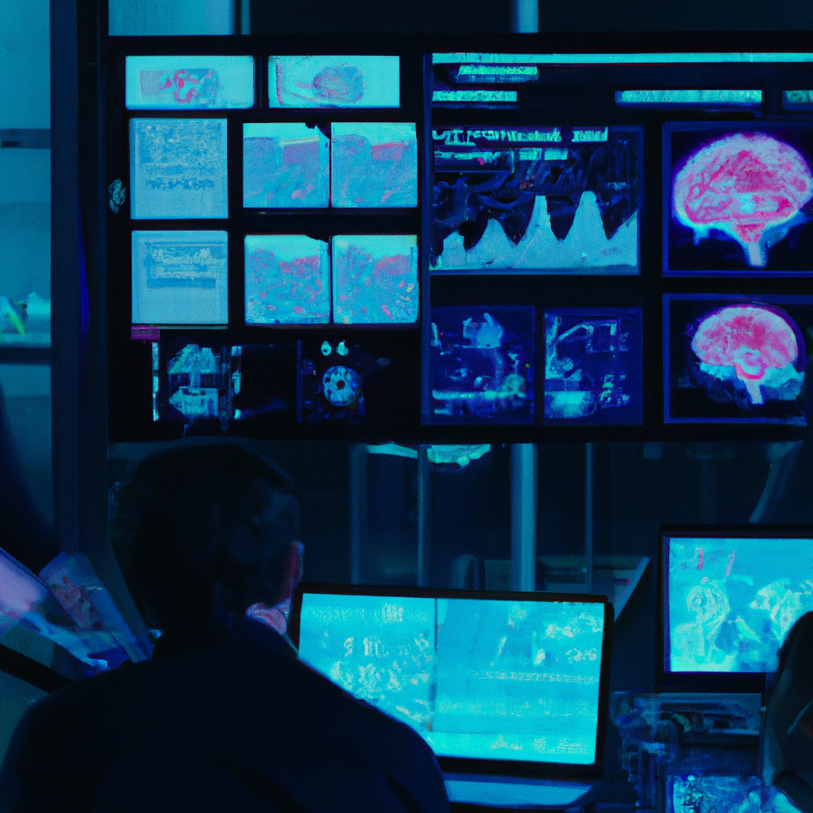
CONCLUSION
Early classification of brain tumors from magnetic resonance imaging (MRI) plays an important role in the diagnosis of such diseases. There are many diagnostic imaging methods used to identify tumors in the brain. MRI is commonly used for such tasks because of its unmatched image quality. This project's purpose is to detect the brain tumor using CNN classification. The proposed technique achieved the maximum performance in brain tumor detection, with 99.70% validation accuracy. This demonstrates the project's efficacy and the possibility of employing CNN to quickly identify brain tumors using MRI.

Slide 19
REFERENCES
Neelum Noreen, Sellappan Palaniappan, Abdul Qayyum , Iftikhar Ahmad, Muhammad Imran, Muhammad Shoaib, 2020, “A Deep Learning Model Based on Concatenation Approach for the Diagnosis of Brain Tumor”, IEEE Access, vol. 08, pp. 55135-55144.
Abdu Gumaei, Mohammad Mehedi Hassan, Md Rafiul Hassan, Abdulhameed Alelaiwi, Giancarlo Fortino, 2019, “A Hybrid Feature Extraction Method with Regularized Extreme Learning Machine for Brain Tumor Classification”, IEEE Access, vol. 07, pp. 36266-36273.
Andres Anaya-Isaza, Leonel Mera-Jimenez, 2022, “Data Augmentation and Transfer Learning for Brain Tumor Detection in Magnetic Resonance Imaging”, IEEE Access, vol. 10, pp. 23217-23233.
Mohamed Shakeel.P, Tarek E. El.Tobely, Haytham Al-Feel, Gunasekaran Manogaran, Baskar.S, 2019, “Neural Network Based Brain Tumor Detection Using Wireless Infrared Imaging Sensor”, IEEE Access, vol. 07, pp. 5577-5588.
Gunasekaran Manogaran, P. Mohamed Shakeel, Azza S. Hassanein, Priyan Malarvizhi Kumar, Gokulnath Chandra Babu, 2018, “Machine Learning Approach-Based Gamma Distribution for Brain Tumor Detection and Data Sample Imbalance Analysis”, IEEE Access, vol. 07, pp. 12-19.

Slide 20
CONTINUED…
Ankit Vidyarthi, Ruchi Agarwal, Deepak Gupta, Rahul Sharma, Dirk Draheim, Prayag Tiwari, 2022, “Machine Learning Assisted Methodology for Multiclass Classification of Malignant Brain Tumors”, IEEE Access, vol. 10, pp. 50624-50640.
Saif Ahmad, Pallab K. Choudhury, 2022, “On the Performance of Deep Transfer Learning Networks for Brain Tumor Detection Using MR Images”, IEEE Access, vol. 10, pp. 59099-59114.

Slide 21
BOOK REFERENCE
Martin C. Brown, Python: The Complete Reference, Fourth Edition, McGraw Hill Education, 2018.
Wes McKinney, Python for Data Analysis, Second Edition, O’Reilly Media Inc., 2017.
Manaranjan Pradhan, U Dinesh Kumar, Machine Learning Using Python, Wiley, 2019.
Aurélien Géron, Hands-On Machine Learning with Scikit-Learn, Keras, and TensorFlow: Concepts, Tools, and Techniques to Build Intelligent Systems, Third Edition, O’Reilly, 2022.
Ian Sommerville, Software Engineering, Tenth Edition, Pearson Education, 2017.

Slide 22
CONTINUED…
Bob Hughes, Mike Cotterell, Rajib Mall, Software Project Management (SIE), 6th Edition, 2017
Alan Dennis, Barbara Haley Wixom, Roberta M. Roth, Systems Analysis and Design, 4th Edition, 2009.
Mohit Sewak, Md. Rezaul Karim, Pradeep Pujari, Practical Convolutional Neural Networks: Implement advanced deep learning models using Python, Packt Publishing Limited, 2018.
Charu C. Aggarwal, Neural Networks and Deep Learning, 1st edition, Springer; 2018.

Slide 23
WEBSITE REFERENCE
https://en.wikipedia.org/wiki/Convolutional_neural_network https://en.wikipedia.org/wiki/Artificial_neural_network
https://www.geeksforgeeks.org/introduction-convolution-neural-network https://en.wikipedia.org/wiki/Brain_tumor
https://iopscience.iop.org/article/10.1088/1757-899X/1055/1/012115/pdf

Slide 24

THANK YOU FOR YOUR ATTENTION

